Slide 1

Deep Learning with Python Transfer Learning
Edgar Lobaton, Ph.D.
Electrical & Computer Engr. Dept.
North Carolina State University

Slide 2
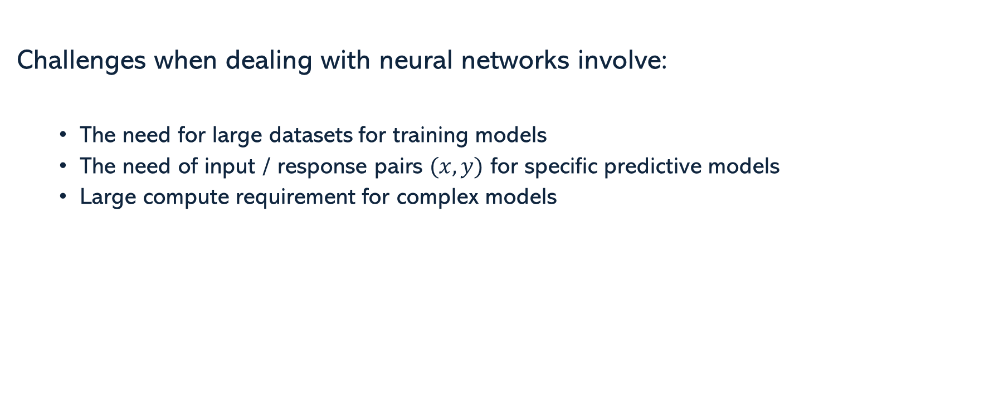
Challenges
Challenges when dealing with neural networks involve:
The need for large datasets for training models
The need of input / response pairs $(x,y)$ for specific predictive models
Large compute requirement for complex models

Slide 3
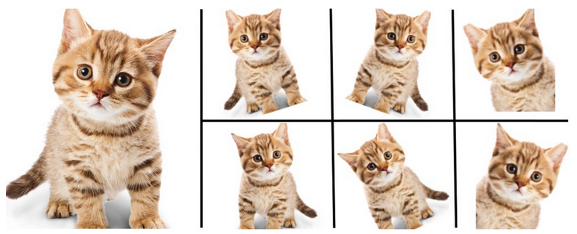
Data Augmentation
There are many way to artificially increment the amount of data that we have for training. For example, via by adding noise to real data, transforming the real data, adding synthetic context to real data, or creating synthetic data.

Slide 4
Transfer Learning: Across Datasets
Parameter Transfer across datasets of the same format often uses a pre-trained model by removing its head and replacing it with a new head appropriate to the new dataset.
The new head is trained by freezing the rest of the network.
This is often followed by fine-tuning of the entire network. The number of steps is a hyper-parameter.
Backbone can be split in other ways
Inference Head
Output
Low-Level Features
Mid-Level Features
Input
High-Level Features
New Inference Head
Output
Freeze
Initial Training
Fine-Tuning

Slide 5
Transfer Learning: Semi Supervised
Autoencoder are an option when there is no labeled data available in the same format from other datasets, but there is enough unlabeled data.
We use the encoder portion of the network and attach an inference head.
Encoder
Decoder
New Classification Head
Input
Output
Output
Freeze
Initial Training
Fine-Tuning

Slide 6
Multi-Task Learning
It can be used to train multiple inference tasks jointly so they can help each other to learn some common features.
It is useful when one or all of the datasets is relatively small.
The cost is the sum of the cost for each inference task separately applied to their corresponding dataset. During training we use a mixed batch.
Inference Head
Inference Head 1
Output
Input 1
Output
Low-Level Features
Mid-Level Features
Low-Level Features
High-Level Features
Mid-Level Features
Input
High-Level Features
Inference Head 2
Input 2
Output

Slide 7
Multi-Task Learning
Some variants may incorporate separate learning of low-level features.
Useful when considering images of different modalities applied to similar tasks, e.g., using infrared images for detection of people, and color images for general object detection.
Inference Head
Inference Head 1
Low 1
Output
Input 1
Output
Mid-Level Features
High-Level Features
Inference Head 2
Input 2
Low 2
Output

Slide 8
Knowledge Distillation
Looks for ways to transfer “knowledge” from large models to smaller models that are easier to deploy
Often the knowledge is transferred by:
Comparing responses
Comparing feature values
Comparing feature relationships
This is very useful for deployment on embedded devices

Slide 9




Thank you
Edgar Lobaton
edgar.lobaton@ncsu.edu
https://research.ece.ncsu.edu/aros/

